Slide 1
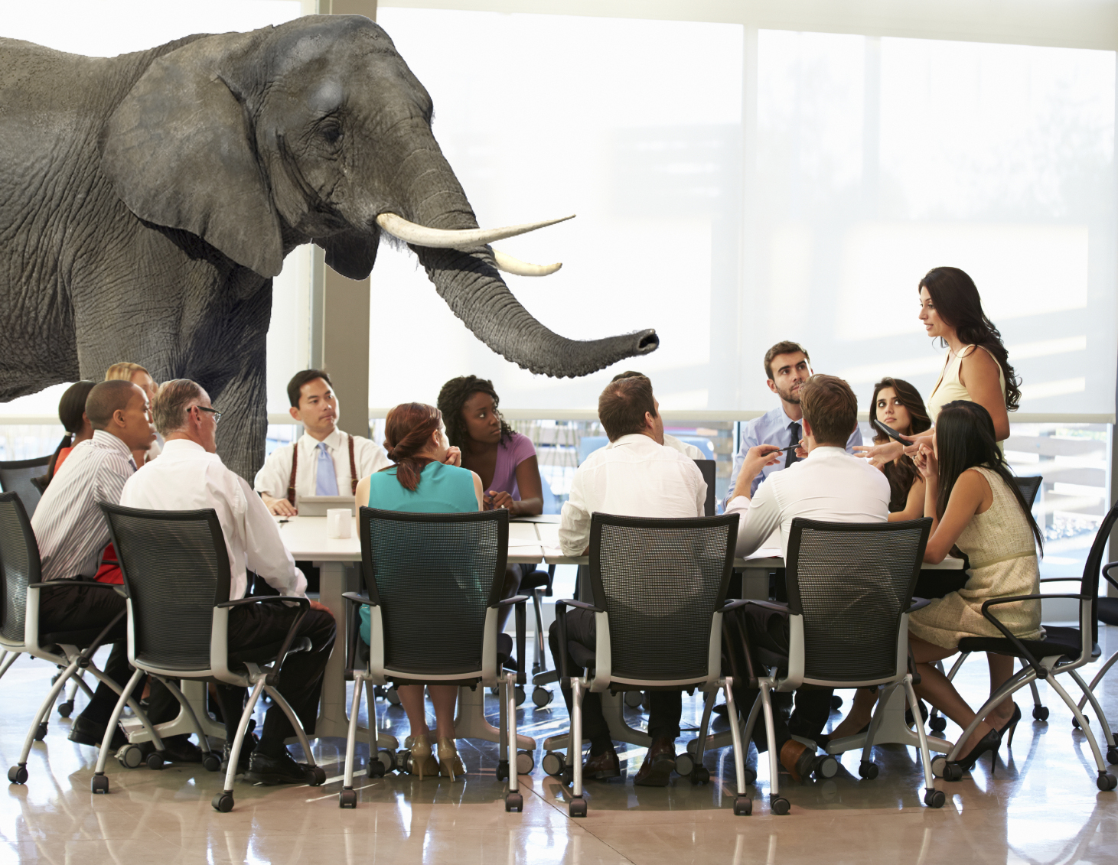

Let’s Get Ready You Ready To Talk About
Race In the Workplace

Slide 2
Your Facilitator
TWANA HARRIS
Senior Consultant
Human Capital Consulting Division
Exude, Inc.
Notes:
Key Talking Points:
-Share your name and “I’m delighted to be your facilitator today.”
-Share your professional background and be sure to align your experience to their industry.
-Set the tone. Let them know this course is interactive and activity oriented. Encourage them to ask you questions throughout the session.

Slide 3
Exude’s Objective
Moving the Needle on
Inclusion, Equity and Diversity
We Change Lives for
People who Change the World

Slide 4
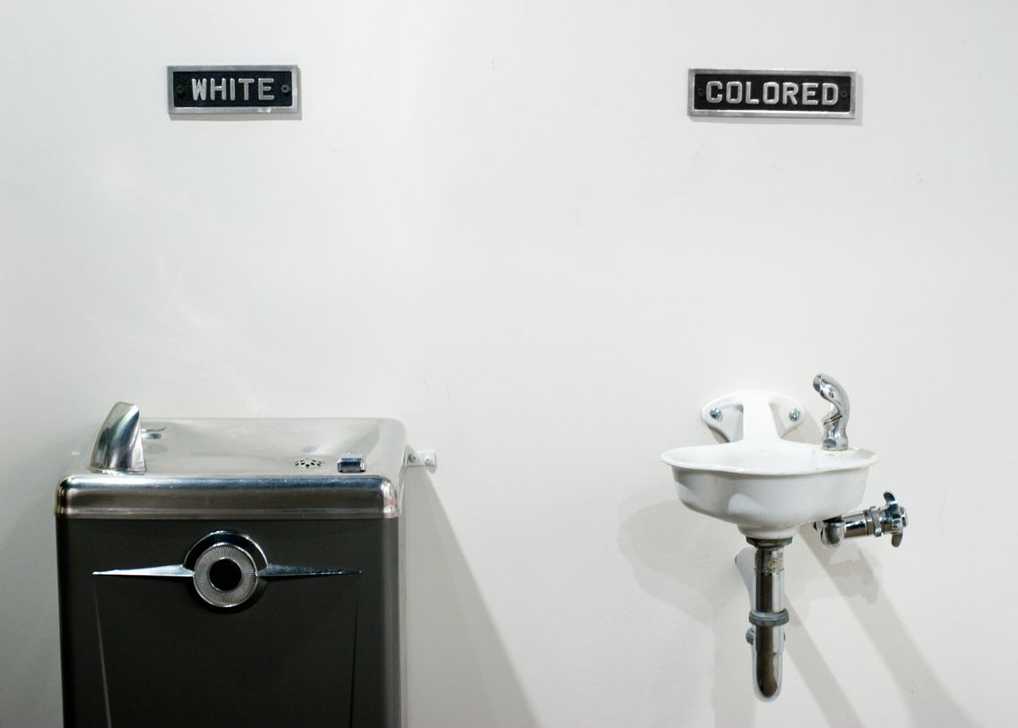
Jim Crow Laws - Did this end with the Civil Rights Act of 1964?
What Remnants of Jim Crow are active in 2020?
Learn about Jim Crow

Slide 5
Discussion Framework
Thank you for your responses.
3 Themes arose and will set the framework for today’s session
  Addressing Racism
  Communication
  What to do Next

Slide 6

THEME: ADDRESSING RACISM

Slide 7
How to address Racism when you see it?
(Unconscious Bias, Systemic White Supremacy, Microaggressions)

Slide 8
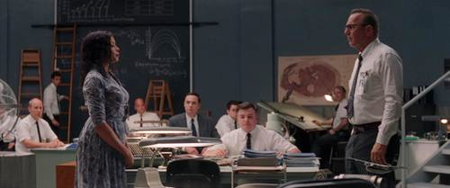
Acknowledgement – Active Listening - Learning

Slide 9
Tips for Addressing Racism
Identify Abolishing Racism as a High-Priority Necessity!
Acknowledgement and Admission
  The Elephant Exists
  There is an obvious problem or difficult situation that people do not want to talk about
Put your Safety Mask on First, then help others
  Assertively introduce yourself to the Elephant in the Room
  Learn, learn! It’s important that you know historical facts, supremacy ideology and misinformation so that you can address Racism with clarity and logic.

Slide 10
Tips for Addressing Racism
Strength your organization position and messaging around “No Tolerance for Racism”
  Critically review all org practices, processes and employee feedback
  Immediately Correct what needs to be corrected
Teach your leaders and workforce how to recognize and report Racism and any other type of Discrimination and/or Harassment
  What is your process for reporting Racism?
  Is it safe – psychologically and professionally?

Slide 11

THEME: COMMUNICATIONS

Slide 12
What should White People Do:
As a white person how should I respond and how do I engage in the conversation?
How to bring white people into the conversation?

Slide 13
Self-Awareness and Knowledge
Karen Fleshman
I think it has to do with how White people understand racial inequality in our society. Growing up, if I asked ‘why is there so much racial inequality in our society?’
The story I would get back is:
“We used to have terrible racism in our society…then there was a Civil Rights Movement led by Dr. King…and now opportunities are distributed equally.”
“Some families choose to seize these opportunities and work really hard and that’s they
I‘ve progressed…and other families choose not to, and that’s why they’re in the situation they’re in.”
Janice Gassam, Forbes Jan 2019 How To Have Conversations About Race At Work

Slide 14
Some Answers for White People?
What’s Your Truth?
Where are Your Blindspots?
Identify and Change; Determine to be a Change Agent
Don’t dwell in “White Guilt”
Invite other White People on the Journey – but if they don’t join you – keep moving.

Slide 15
Some Answers for White People?
Recommended Reading:
Dear White People: Here Are 10 Actions You Can Take To Promote Racial Justice In The Workplace

Slide 16
How to talk about it and facilitate conversations:
How to talk about when we normally don’t?
How to talk about with empathy?
What to say and how to say it?
Talking with Employees:
How to take on challenging race related questions that employees may have or experience within their work environment.

Slide 17
Tips for Workplace Conversations about Race
If you need it --Practices --Begin with Friends
  Call a friend of color this week to discuss the current state of protest and upheaval
  Share that you want to be a Change Agent and ask for their assistance –can you run things by them going forward?
Courageous Workplace Conversations
  Engage in teachable moments with people who exhibit unconscious bias in decision making; appropriately challenge behaviors that are inconsistent with your organization’s commitment to DEI.
    1:1 and start with your intent – to help

Slide 18
Tips for Workplace Conversations about Race
Facilitate Courageous Workplace Conversations on Race
  The Elephant is in the Room!!
  Conversations can be in Teams, Meetings, Lunch-n-Learns, Training and 1:1s as needed
  Teach everyone how to have productive conversations about Race; how to have teachable moments
  Hold yourself and everyone accountable for identifying and removing Racist behaviors and remarks from your organization.
Always respond to employees or colleague communications around Race and/or how they are feeling about the protests or social justice issues
  Never go silent
  Communicate with Empathy

Slide 19

Empathy Is…
Notes:
Key talking points
-Define Empathy by walking through the word cloud
-Hear, Connect, Compassion, Compassionate, Communication, Needs, Presence, Communication, etc.

Slide 20

Empathy - Understanding

Slide 21
Empathy Statements for Coworkers and Employees
Examples:
I know you've put so much time and effort into this, and it has to be frustrating to see the project shut down.
Uncertainty is really hard.
That has to be confusing and discouraging.
If that happened to me, I would feel upset too.
Times of change are hard, and it's totally normal that you're feeling angry about this.
I would be upset if someone talked to me that way too.
I can hear your concern in your voice.
You must feel like no one even listened to you.
I know it isn't easy to deal with social injustice, what can I do to help?
It's been a difficult couple of weeks, hasn't it?

Slide 22
Tips: 7 Ways to Improve Your Empathy
Listen
  Truly listen to the other person; listen with the intent to understand them. Stop your mental clutter and put down your smartphone.
  Be willing to open-up to share our innermost thoughts and feelings it's a process of give-and-take
Use empathetic language
  Phrases such as “I'm sorry that happened to you”, “I don't blame you for feeling that way”, or “I'm sure I'd feel the same way if I were in your position”
  You must be sincere when saying them
  The act of saying apathetic words and phrases can serve to make us more aware of what other’s are experiencing.
Notes:
Key talking points
-Techniques are in the workbook
-Walk through the techniques

Slide 23
Tips: 7 Ways to Improve Your Empathy
Don't be Judgmental
  Understand that we all approach life from a unique perspective and that no one's experience is the same as another’s
Practice curiosity about others
  Part of being empathetic is being interested in other people
  Ask questions about where they're from, their beliefs and their values without being judgmental
  Let them talk without jumping in with your own perspective
Notes:
Key talking points
-Techniques are in the workbook
-Walk through the techniques

Slide 24
Tips: 7 Ways to Improve Your Empathy
Challenge your own prejudices just
  Because you believe something doesn’t mean it's true; don't believe everything you think
  Put yourself in situations where you might hear philosophical or political
  discussions that differ from your beliefs and just listen
Look for commonalities instead of differences
  Make no mistake about it each of us is unique and we have many differences between us we also have a lot in common
Notes:
Key talking points
-Techniques are in the workbook
-Walk through the techniques

Slide 25
Tips: 7 Ways to Improve Your Empathy
Avoid labeling people
  It’s a lot easier to hate a label than a person
  We get to know each other as people not as Democrats or Republicans Christians or Muslims blacks or whites or whatever opposing labels you choose
  We realize that in spite of our differences we’re all connected in any ways working on
*Don Crawley, Ways to improve empathy
http://www.doncrawley.com
Notes:
Key talking points
-Techniques are in the workbook
-Walk through the techniques

Slide 26

THEME: WHAT TO DO NEXT
Notes:
Intro slide

Slide 27
How to get senior leadership on board? What should leadership be doing/saying?
How do we take action? Be a part of positive change? Not be lip service?

Slide 28
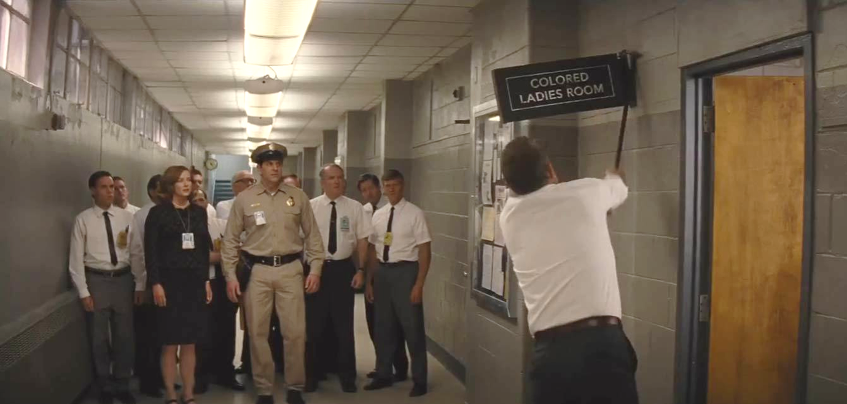
Action - Declaration
“No more Colored Restrooms, no more White Restroom, just plain old toilets.”
“Here at NASA we all pee the same color”

Slide 29
Action
Build accountability loops for all leaders to drive sustainable behavioral change.
  A critical step in accomplishing organizational change is to clearly communicate expectations and “really” hold leaders accountable to the point of determining if all of your leaders “fit” your organization’s commitment to diversity and inclusion, and to take action if they don’t.
  It’s time to make your inclusion objective as important as every other business objective. We can no longer allow this to be put on the back burner.

Slide 30


Action – Execution - Change

Slide 31
Action
Touchbase with every employee. Yes, every employee.
  Know your people, what is happening to each of them, and where necessary, change their situation immediately. This will positively impact their performance and your profitability.
  Most employees will not tell you they’ve been “treated differently, unfairly, and discriminated against”; instead, they leave. This attrition is extremely costly and presents a critical risk.
  Your brand reputation will be besmirched and may never recover. Additionally, the cost of replacing the lost talent is at least fifty percent of their annual salary. This is akin to throwing thousands of dollars into an incinerator for each person who leaves your organization, as well as all of your marketing dollars.

Slide 32

Questions?
Notes:
Key talking point
-Are there any questions?

Slide 33
An exclusive conversation for the Exude Community
Please join us, and dozens of your peers in other companies ready to have the conversation around race in the workplace.
You will be broken into groups of 10-20 participants.
Someone from Exude will be in contact with your group and to schedule a time that works for your team.
We will collect your questions and topics suggestions in advance.
I will facilitate and guide the conversation based on your input.
Hoping to host these in the next 30days.
If you’re interested, please complete the link that was just sent out via chat https://www.exudeinc.com/continuing-the-conversation/ - it will also go out in the follow-up communication.

